Slide 1


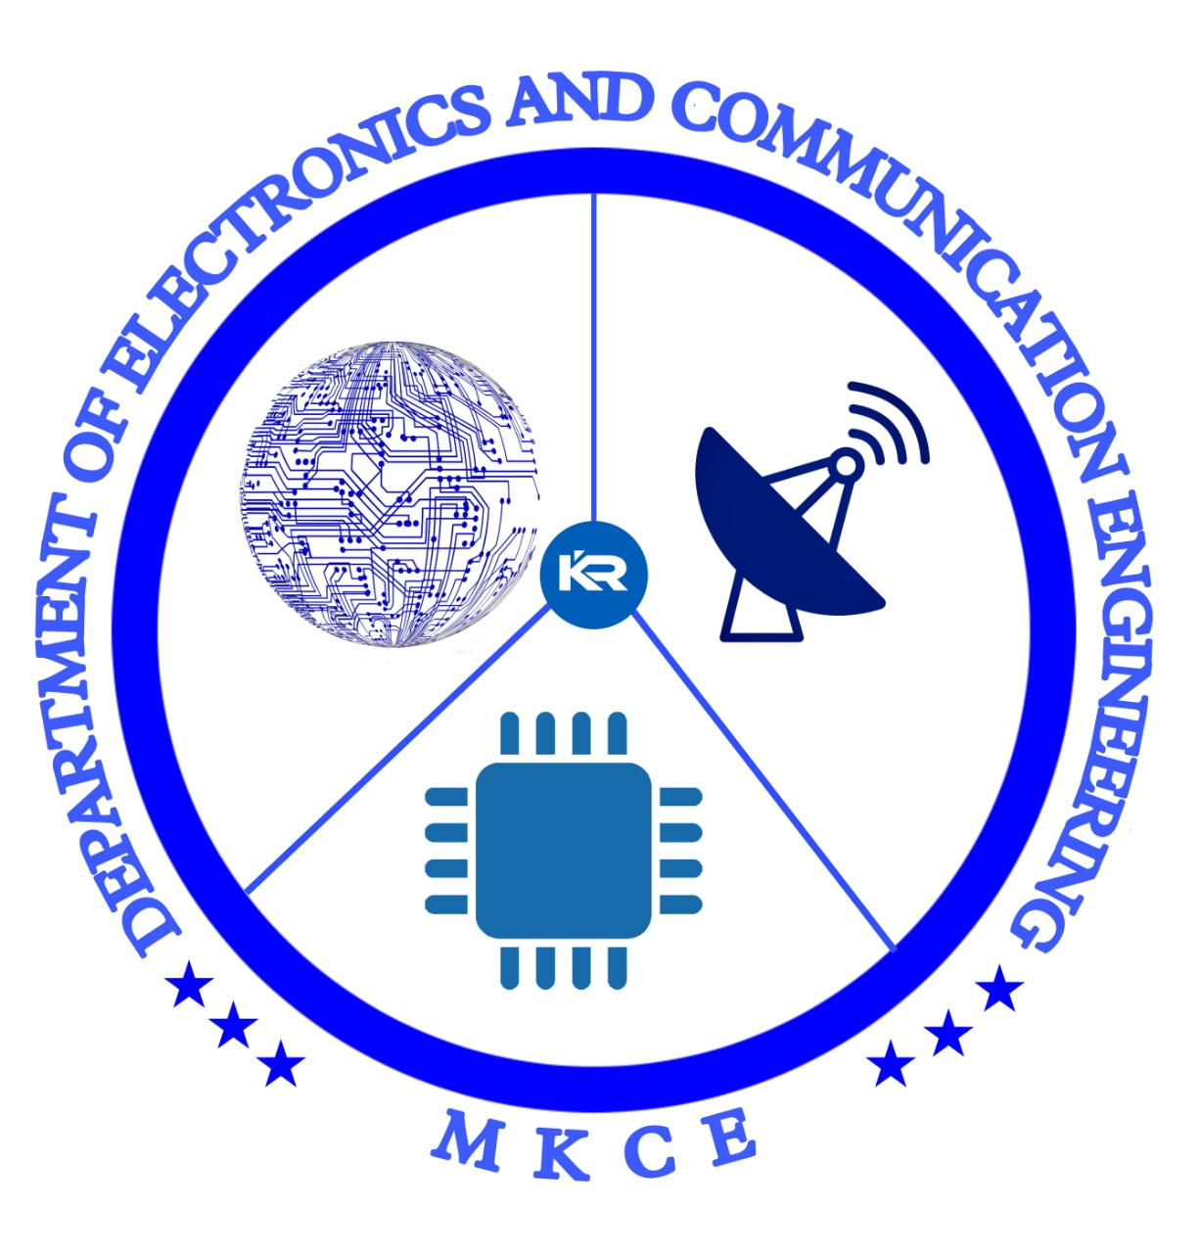


Batch-18 Minor Project
REMOTE CONTROLLER
GUIDED BY,
Mrs.T.Abirami, Assistant Professor

Slide 2
TEAM MEMBERS
MAHENDRAVARMAN R S [927621BEC111]
KUMAR N [927621BEC098]
MOHANPRASATH S [927621BEC125]
MALLESH S [927621BEC112]
SANTHOSH P [927621BEC311]

Slide 3
ABSTRACT
This project involves the design and implementation of a universal remote controller using Attiny 85 microcontroller.
The Attiny 85 microcontroller is a low-power, high-performance chip that is capable of controlling multiple IR devices.
The remote is designed to work with a variety of electronic devices, including TVs, DVD players, and audio systems.

Slide 4
INTRODUCTION
A universal remote is a device that can be programmed to control multiple electronic devices, eliminating the need for multiple remotes.
The Attiny 85 microcontroller is a popular choice for remote control applications due to its low-power consumption, small size, and high-performance capabilities.
The main objective of this project is to design a universal remote that can control various electronic devices using infrared (IR) signals.

Slide 5
PROPOSED METHOD
The proposed method for designing the universal remote using Attiny 85 involves several steps.
The first step is to design the circuit diagram for the remote, which includes the Attiny 85 microcontroller, IR receiver and transmitter, and other required components.
The second step is to program the Attiny 85 microcontroller using the Arduino programming language, to decode and transmit IR signals to control the target devices.

Slide 6
PROPOSED METHOD
The third step is to test the remote by connecting it to different electronic devices and ensuring that it can control them.
The fourth step is to construct the physical remote using a compact design and a simple button interface.
The final step is to optimize the code and circuit design to ensure that the remote operates reliably and efficiently.
The proposed method will be implemented by following standard design principles and using appropriate tools and equipment.

Slide 7
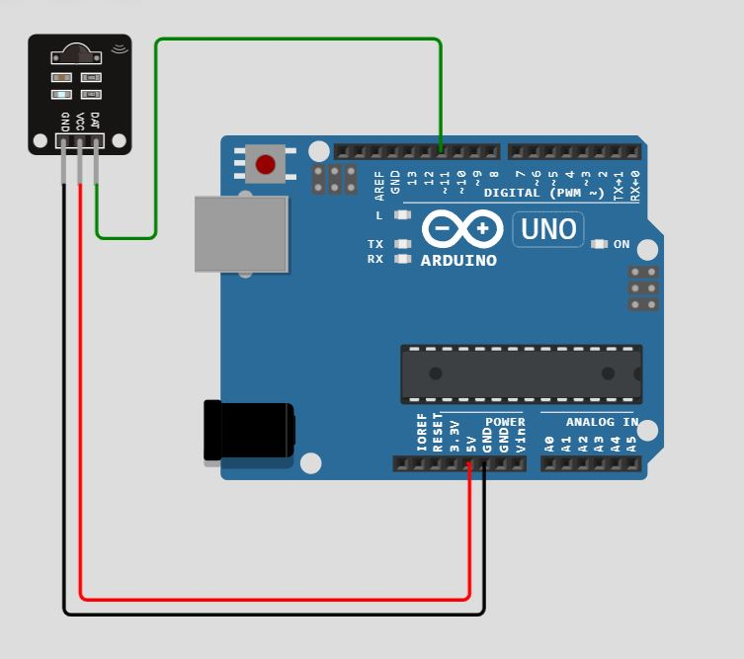
RECIEVER CIRCUIT

Slide 8
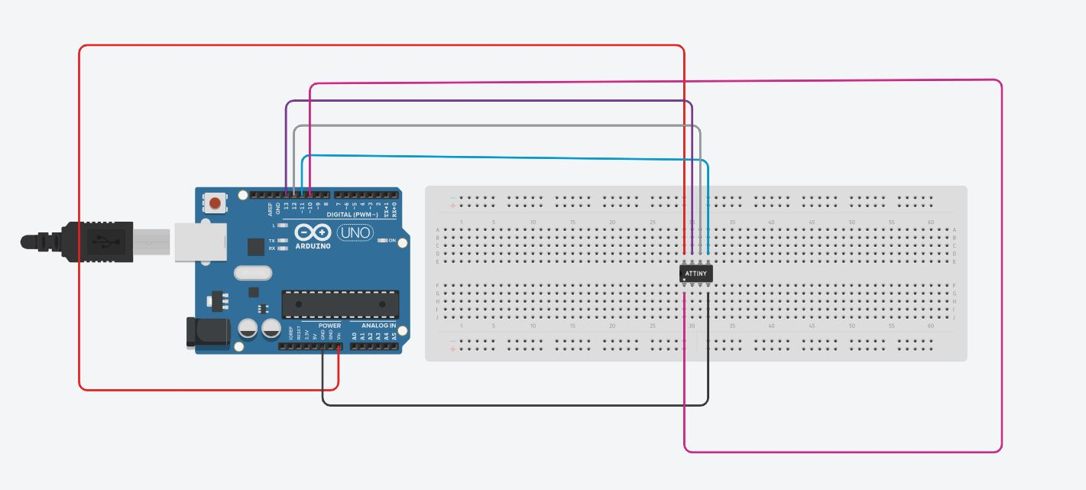
PROGRAMMING CIRCUIT

Slide 9
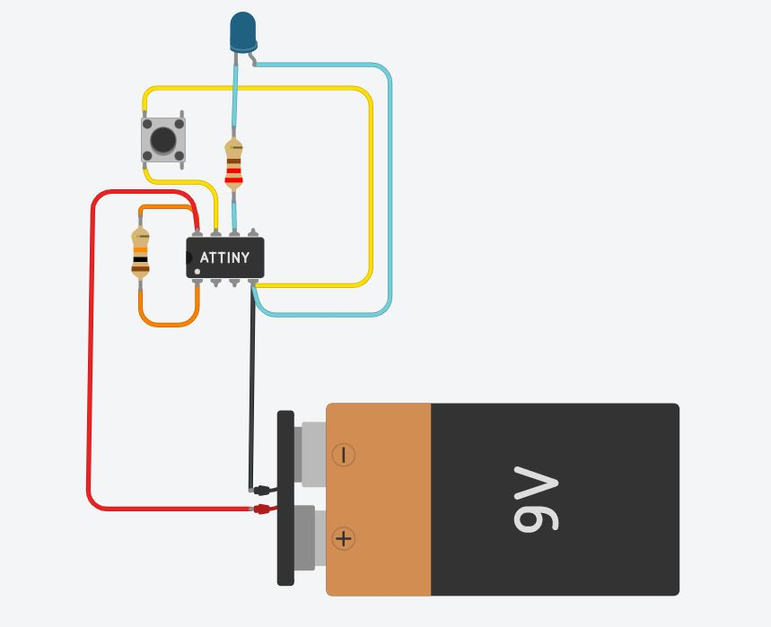
TRANSMITTER CIRCUIT
3.7V

Slide 10
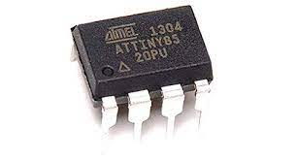
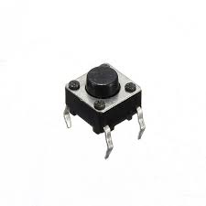
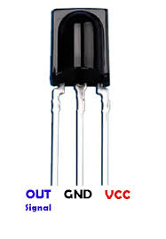
COMPONENTS REQUIRED
Attiny 85 microcontroller.
Push buttons.
10K,220Ω Resistors.
IR Reciever and LED.
Arduino UNO (For Reciever circuit).
Battery.

Slide 11
FUTURE WORK
The future work for the design of the universal remote using Attiny 85 involves several areas of improvement and expansion.
One potential area of future work is to increase the range of the remote by using a more powerful IR transmitter or adding a signal amplifier circuit.
Another area of future work is to add Bluetooth or Wi-Fi connectivity to the remote, allowing it to control devices wirelessly and potentially enabling voice control functionality.

Slide 12
THANK YOU

